Slide 1
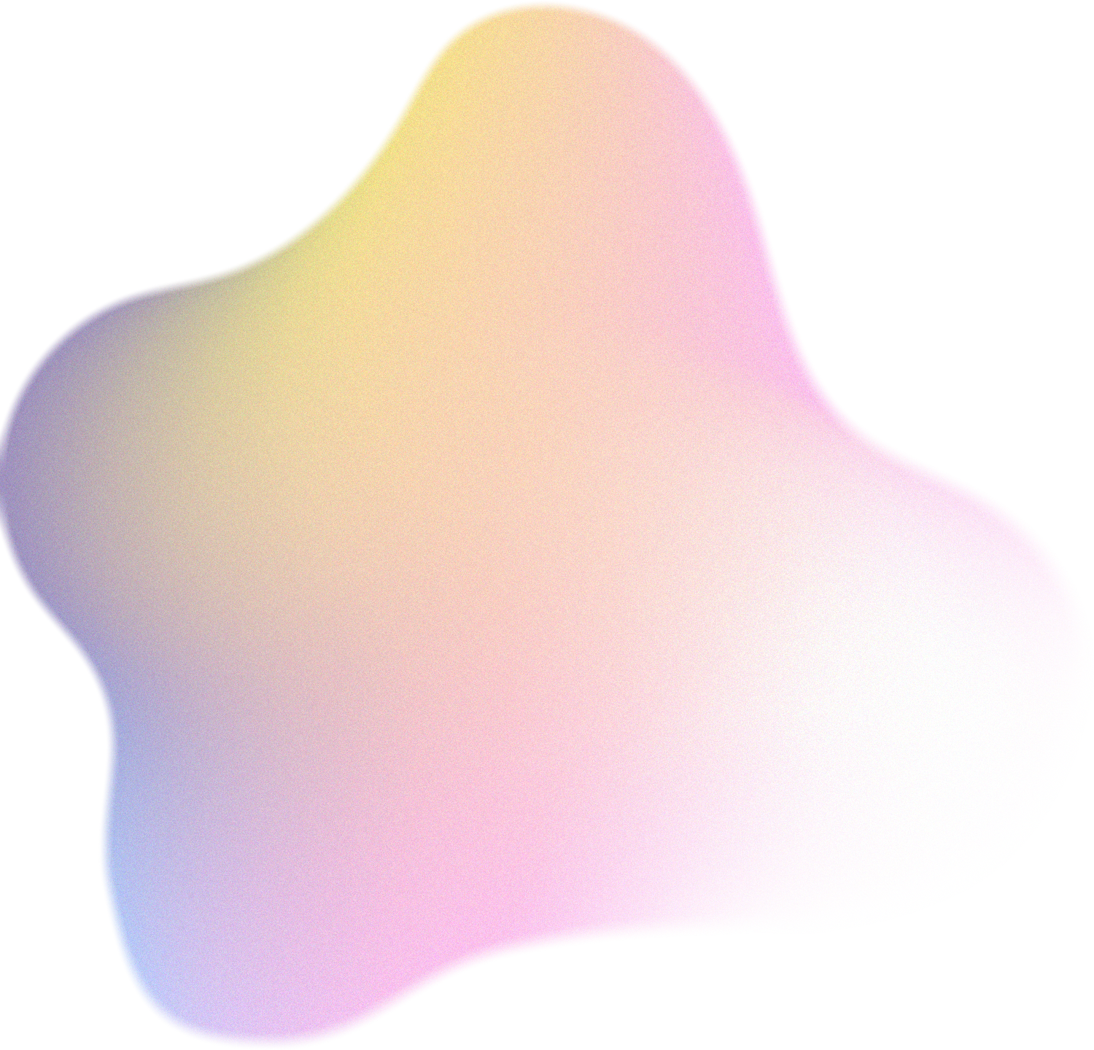
LENNA
“Language Enhanced Reasoning Detection Assistant”
Fei Wei1, Xinyu Zhang1, Ailing Zhang1,2, Bo Zhang1, Xiangxiang Chu1*
Ujwal Kirsan
DA323: Multimodal Data Processing Project
220150026, DSAI

Slide 2


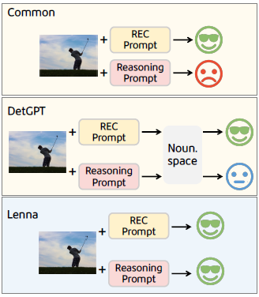
Motivation
Rapid advancement of Multimodal LLMs (MLLMs)
Existing models struggle with implicit reasoning in object detection
Lenna aims to bridge the gap between natural language understanding and precise visual detection

Slide 3
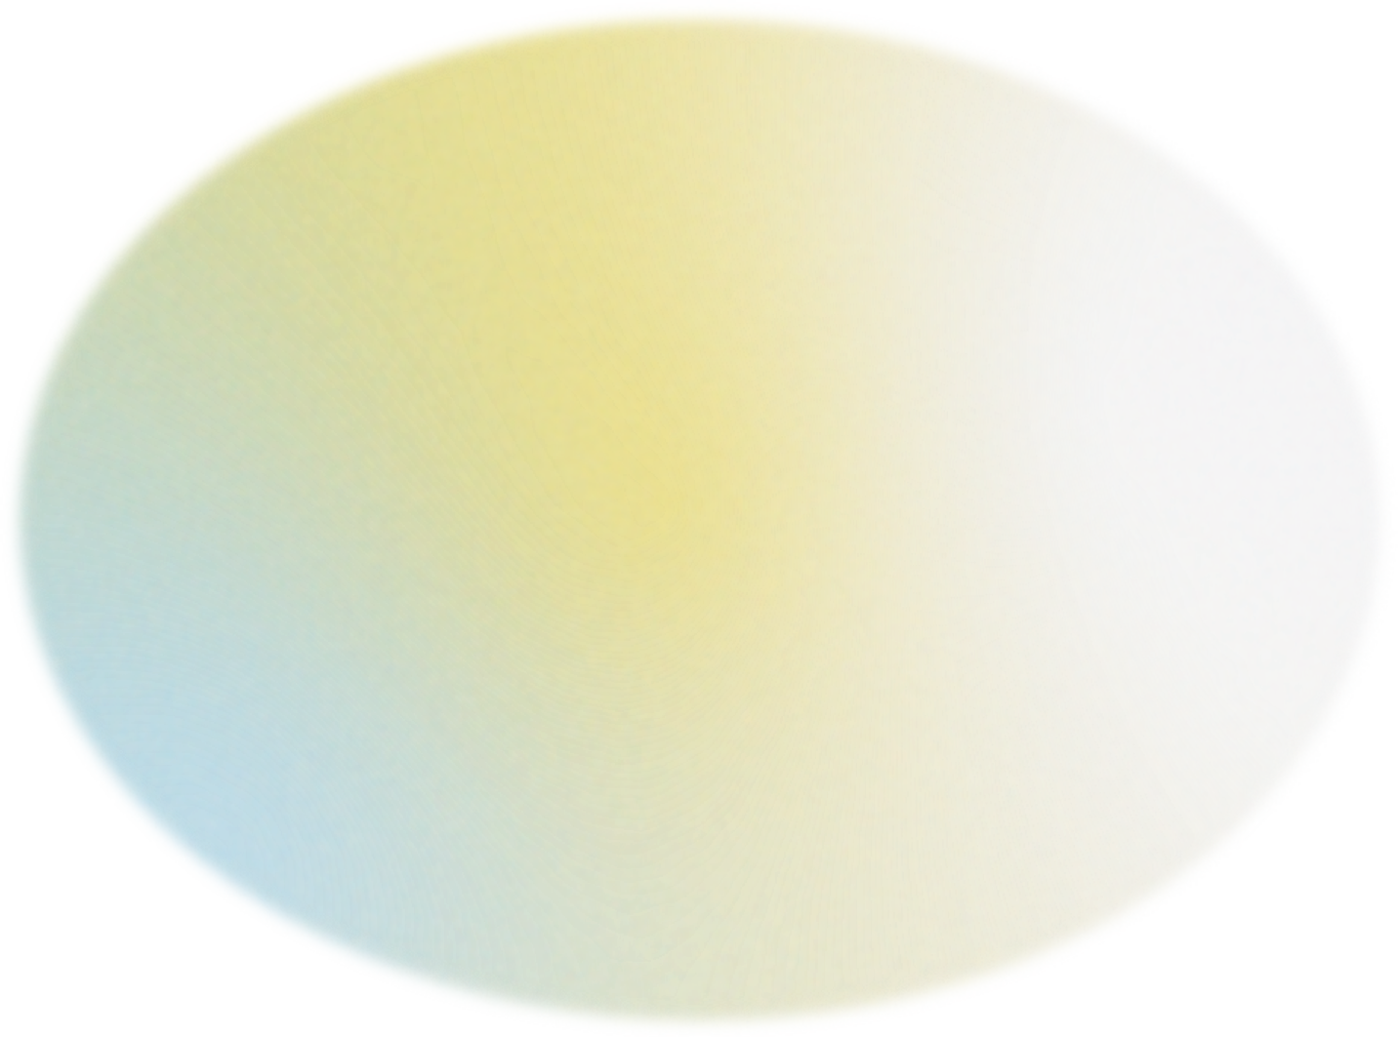
Problem Statement
Limitations of prior models:
Inability to handle reasoning-based visual queries
Loss of localization context in MLLMs
Key Research Questions:
Can MLLMs reason and localize simultaneously?
How to incorporate detection prompts into MLLMs effectively?

Slide 4
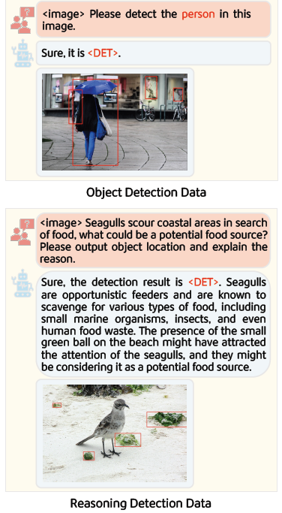
Background - Multimodal Learning
Past Work:
VQA, Captioning → GLIP, MDETR, Grounding-DINO
Recent Trends:
MiniGPT-v2, Shikra, DetGPT → Unified vision-language interfaces
Need:
Bridging reasoning + detection with minimal overhead

Slide 5

Lenna’s Core Idea
Innovation:
Introduction of a <DET> token as a detection signal in MLLMs
Function:
Embedding <DET> to preserve location info while handling language-based reasoning

Slide 6
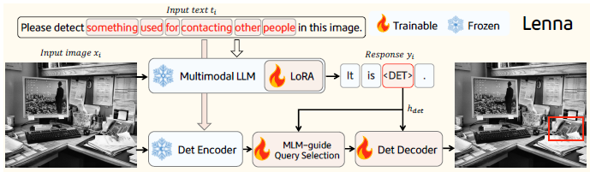
Architecture Overview
Components:
LLaVA-based LLM
Grounding-DINO as open-set detector
MLM-guide Query Selection (MQS) for alignment

Slide 7
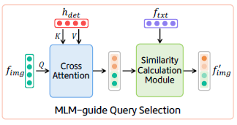
MQS Module
Function:
Cross-attention + Similarity Matching between image features and <DET> token embedding

Slide 8
Training Strategy
Training Duration:
~20 hours on 8×A100 GPUs
Frozen LLaVA; LoRA fine-tuning
MQS and decoder trained from scratch
Training Process
yᵢ = M(xᵢ, tᵢ)
f_img, f_txt = D_enc(xᵢ, tᵢ′)
f′_img = MQS(h_det, f_img, f_txt)
pred = D_dec(h_det, f′_img)
L = λ_tok * L_tok + λ_det * L_det
L_tok = - ∑ log p(yⱼ | yⱼ′ < j, xᵢ, tᵢ)
L_det = λ_L1 * L1 + λ_GIOU * GIOU + λ_Contrast * Contrast
Data Types Used:
Object Detection (COCO)
Referring Expression Comprehension (RefCOCO)
Reasoning Detection (ReasonDet)
VQA (LLaVA-Instruct-150k)

Slide 9
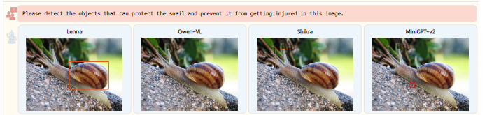
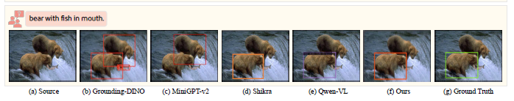
Results
Visualization comparison of reasoning capability with generalist VLMs.
Visualization comparison with other VLMs on various referring expressions.

Slide 10
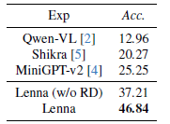
Results
Highlights:
Lenna surpasses MiniGPT-v2, Shikra, and Qwen-VL in accuracy
Lenna with ReasonDet: 46.84% accuracy vs others ~20–25%

Slide 11





Analysis and Conclusion
Use of <DET> bridges the vision-language gap
Efficient use of frozen LLM weights with LoRA
MQS ensures deep feature alignment for both modalities

Slide 12


Thank you!

